Slide 1
Introduction to philosophy Lecture 3
PHI1101
Dr. Lucas Scripter
Lecturer in General Education
School of Humanities and Social Sciences
Chinese University of Hong Kong, Shenzhen

Slide 2

Three ways of conceiving of philosophy
Philosophy as a Way of Life
Philosophy as the Foundation of the Sciences
Philosophy as Conceptual Analysis

Slide 3
REVIEW

Slide 4


Philosophy as a way of life 1
Pierre Hadot’s idea of “philosophy as a way of life” includes four key aspects:
1. Goal of Philosophy:
Self-Transformation
2. Setting of Philosophy:
Practiced in a Group or School
3. Psychological Assumption:
Philosophical training can lead to a change in human beings.
4. Metaphysical Context:
Philosophers should cultivate ‘cosmic consciousness’

Slide 5
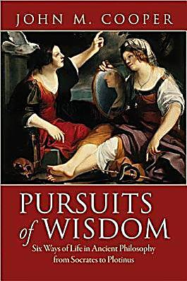
Philosophy as way of life 2
John M. Cooper (2012) has also argued that ancient philosophy is best understood as a ‘way of life’, but he emphasizes something different than Hadot.
“To live a life of philosophy is to live committed to following philosophical reason wherever it may lead. The promise is that by doing so—but only by doing so—one will achieve the best possible human life” (p. 18)
5. Living according to Reason
Conducing one’s life according to reason (not custom or religion)

Slide 6
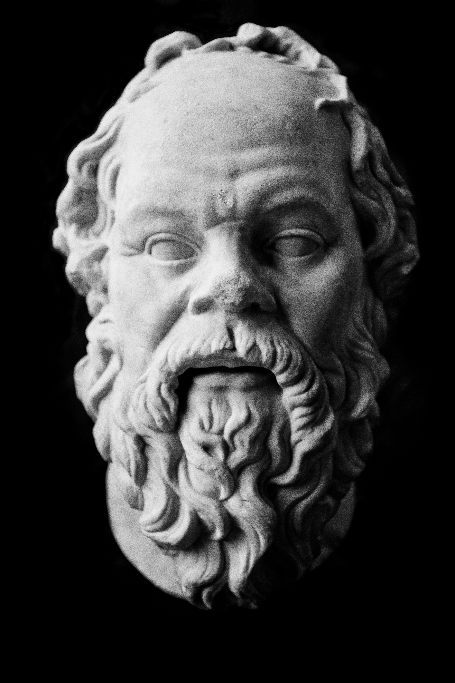
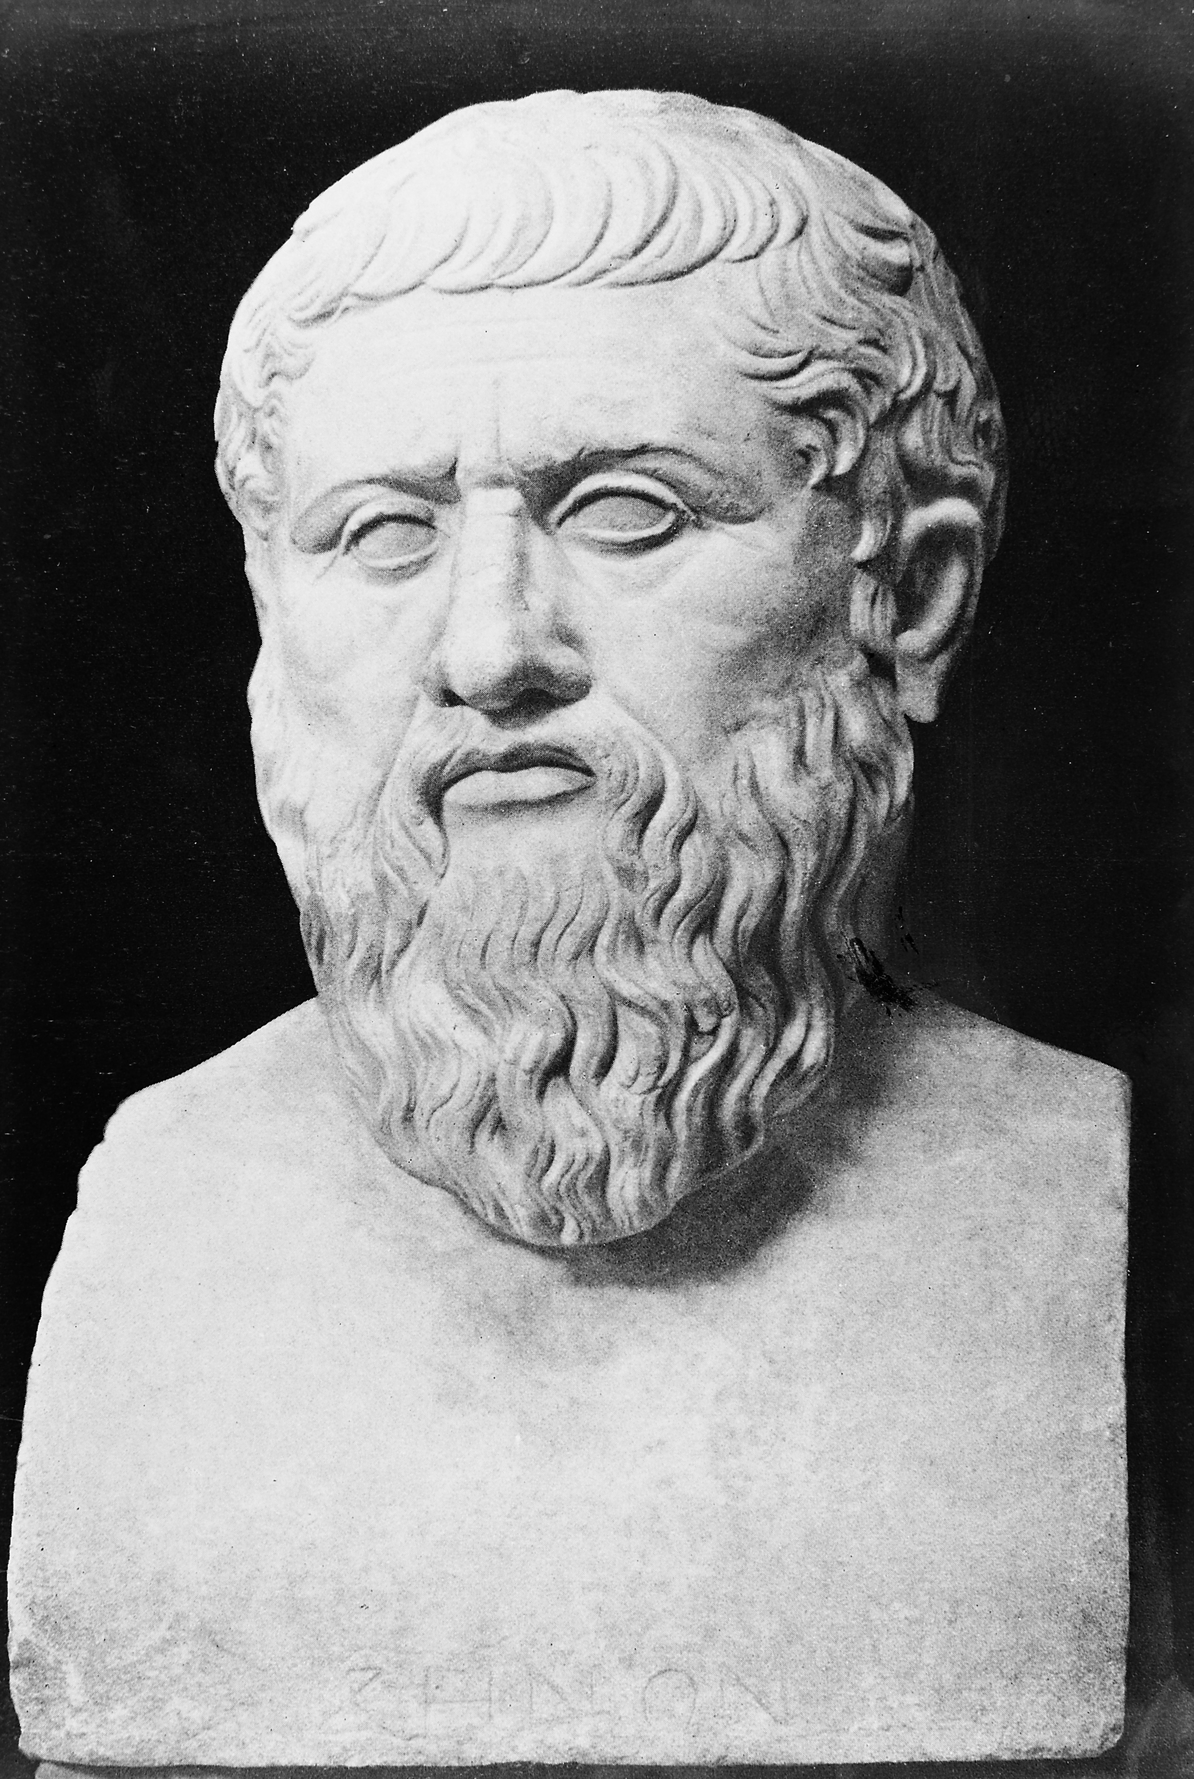
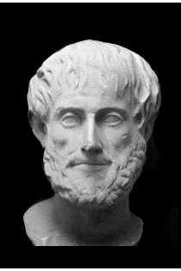
The three greats
Socrates
(470-399 BCE)
Plato
(approx. 428-348 BCE)
Aristotle
(384-322 BCE)

Slide 7
Hellenistic schools

Slide 8
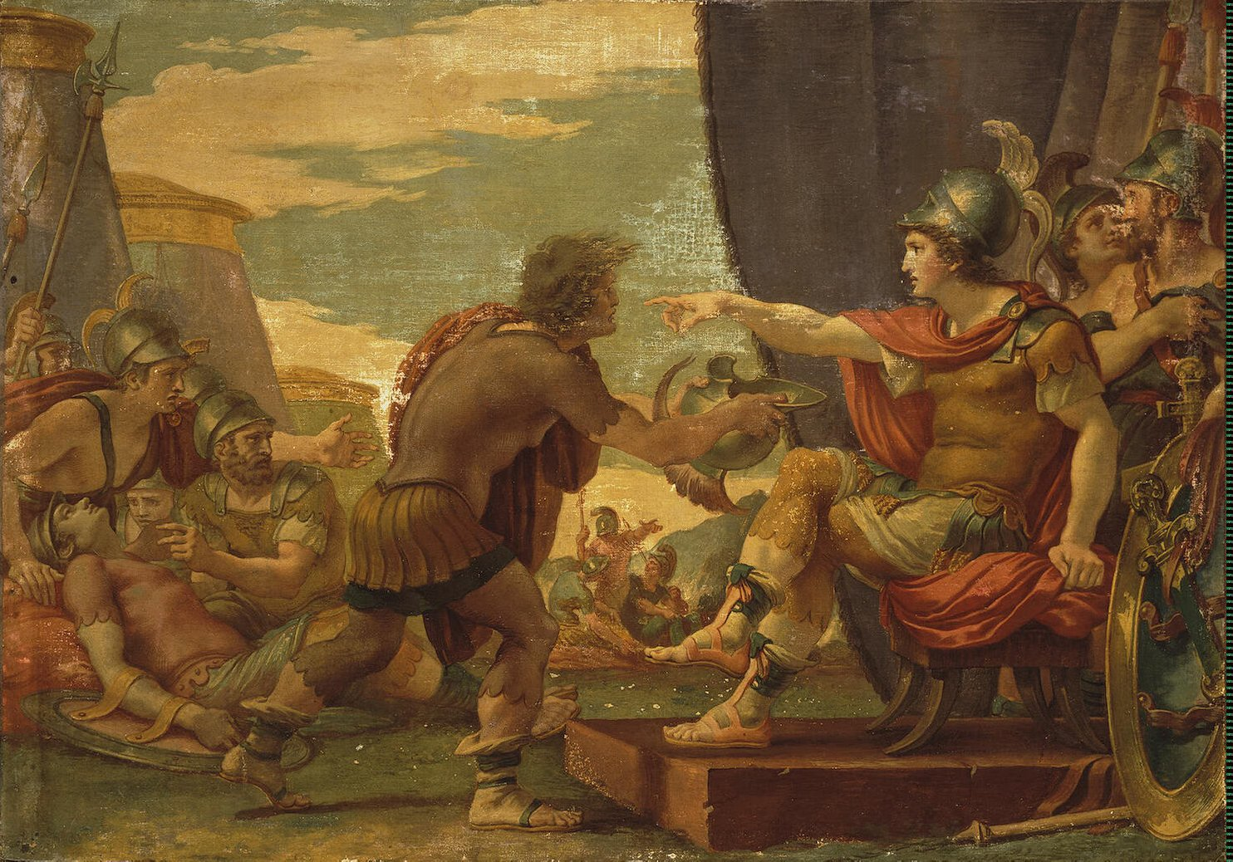
transition to the Hellenistic period
The conquests of Alexander the Great (356-323 BCE) brought about an end to the Greek city state system and the beginning of a Hellenistic empire.
Philosophy’s New Role in New Political Environment:
“In the great centralized state of which he was now a subject, the citizen of the old small city asked himself what attitude he should take up; he felt lost. Then he turned upon himself, considered his inner salvation, asked to be told what was the object of life, to be given an ideal in pursuing his own happiness. The ideal might be different in every school, but it would always be the ideal of the Wise Man, who belongs to no age or country; all would conceive him in the same resolutely pragmatic spirit” (Robin, p. 313, italics mine).

Slide 9
Hellenistic schools
Plato’s Academy
Aristotle’s Lyceum
The Cynics
The Skeptics
The Epicureans
The Stoics

Slide 10
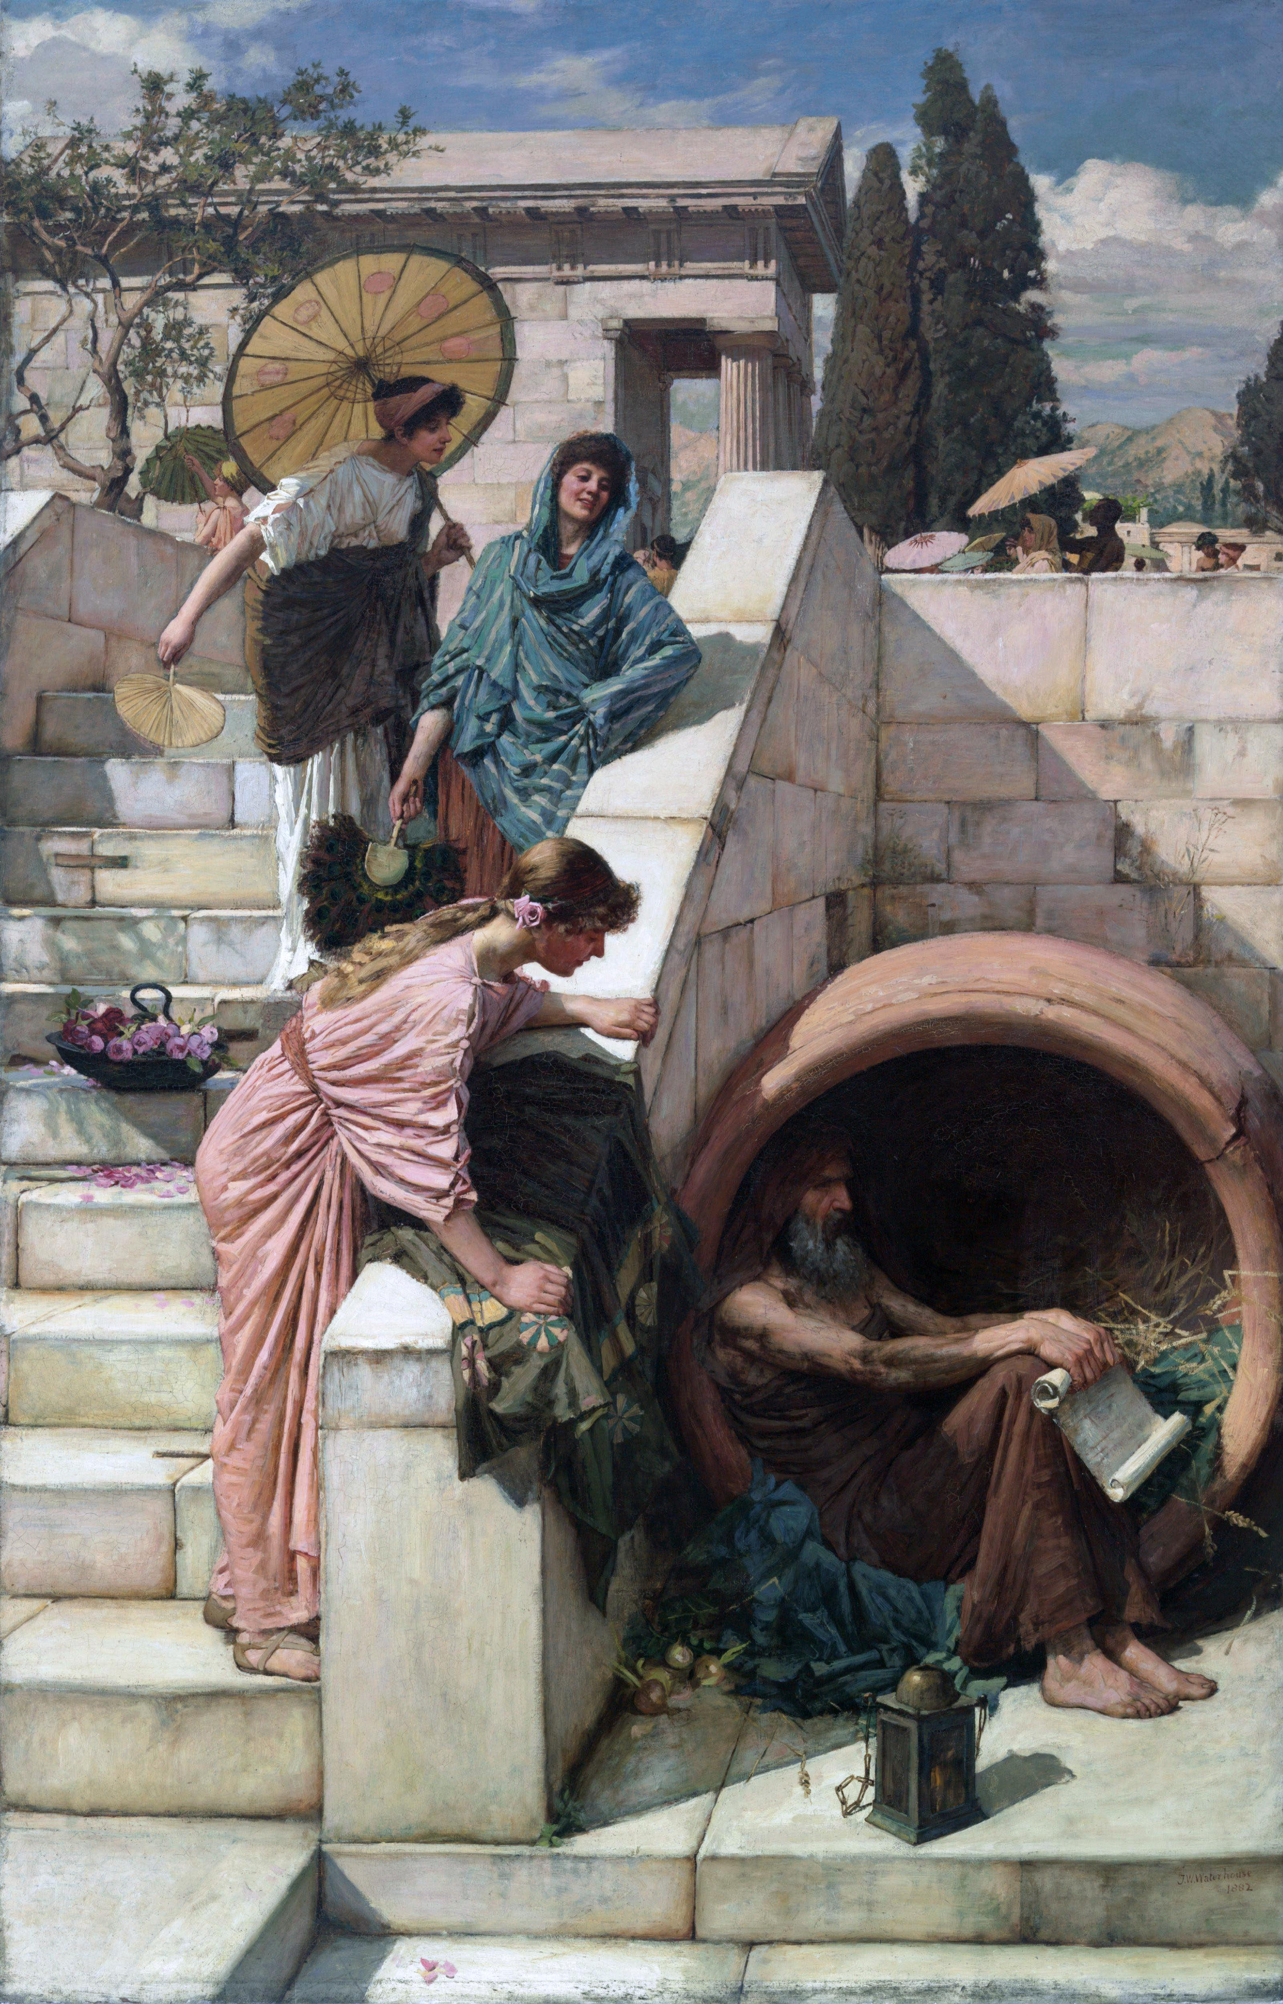
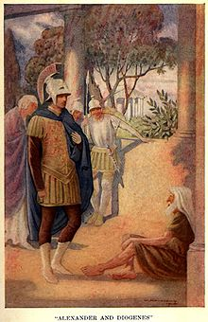
The cynics
The Cynics criticized social convention (nomos) and urged a return to nature (physis). The happy life was seen as following the way of nature like animals or children.
Among the most famous philosophers was Diogenes the Cynic, who lived in a barrel in Athens and engaged in unconventional behavior. There are no surviving writings from him.

Slide 11
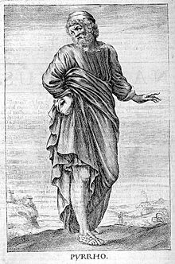
The skeptics (pyrrhonism)
The Skeptics were a school of ancient philosophy that sought happiness in indifference and suspension of judgment.
According to the Skeptics, philosophical belief was disruptive to peace of mind.
To combat this, the skeptics developed argumentative techniques designed to bring the mind to an equilibrium of arguments for and against resulting in a suspension of belief called epoche.

Slide 12
epicurean philosophy

Slide 13

Misperceptions of epicureanism
Epicureanism is popularly understood as unrestrained hedonism. It is the pursuit of luxurious pleasures to an extreme degree.
Epicurus was in ancient times also slandered with such a reputation:
The following quotation was falsely attributed to him “As far as I am concerned, I do not know how I can think of the good if I subtract the pleasures of taste and the pleasures of sex, sound and form.”
The Stoic Epictetus said he was a “foul-mouthed bastard.”
Epicurus was said to have vomited twice a day (from over-indulgence) and that his body was wrecked from excessive indulgence (from ‘the Life of Epicurus’ by Diogenes Laertius in The Art of Happiness, pp. 81-82).

Slide 14
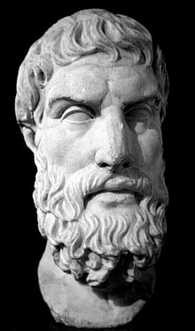
Epicurus
According to the biography found in ancient author Diogenes Laertius, Epicurus was:
A simple person—contented with bread and water.
A benevolent person—who lived with his friends.
A prolific author—his writings took up more than 300 scrolls, most of which, unfortunately, have been lost.
Epicurus (341-270 BCE)

Slide 15
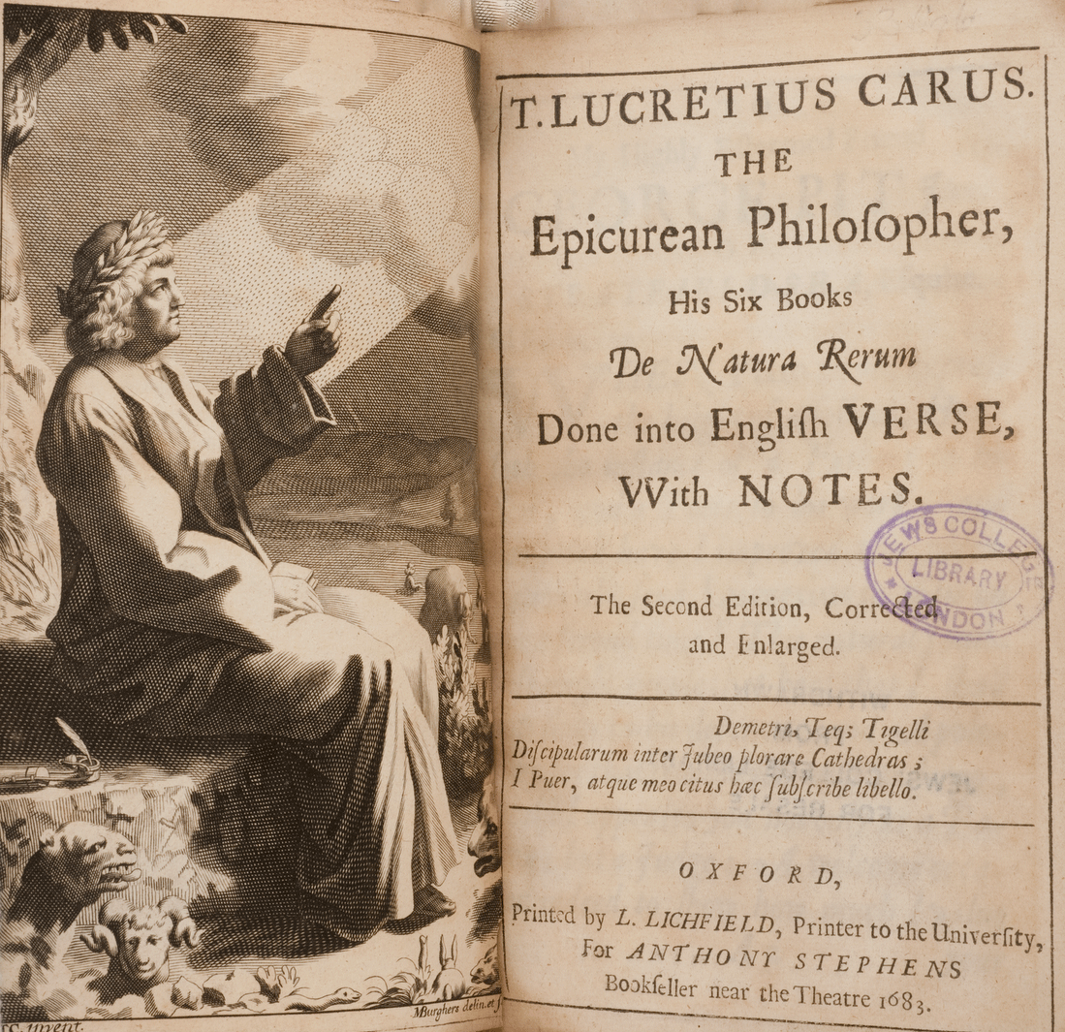
Lucretius
Author of De Natura Rerum (On the Nature of Things), an epicurean poem written during the Roman Republic.
On the Nature of Things offers a materialistic account of the nature of the world and introduces the idea of ‘the swerve’ of atoms to explain their collision and the formation of complex bodies.
On the Nature of Things also presents arguments against fearing death.
Lucretius (99-55 BCE)

Slide 16

Epicurean Ethical philosophy

Slide 17
Epicurean view of happiness
Pleasure
Happiness
For the Epicureans, the fundamental aim of human beings is happiness understood as pleasure:
“we speak of pleasure as the starting point and the goal of the happy life because we realize that it is our primary native good, because every act of choice and aversion originates with it, and because we come back to it when we judge every good by using the pleasure feeling as our criterion.” (Letter to Menoeceus, p. 158)

Slide 18
Two kinds of Pleasure
For Epicurus, the most stable form of pleasure does not stem from movement, e.g., partying, sexual activity, money-making, etc., but rather from a life of relaxation. Pleasures from movement incorporate pains; pleasures without movements do not.
“No pleasure is bad in itself. But the things that make for pleasure in certain cases entail disturbances many times greater than the pleasures themselves.” (Leading Doctrines 8)
Epicurus held that a life where our physical and mental pains had been eliminated would be in itself pleasurable.
“The quantitative limit of pleasure is the elimination of all feelings of pain. Wherever the pleasurable state exists, there is neither bodily pain nor mental pain nor both together, so long as the state continues.” (Leading Doctrines 3)
Pleasure from Movement
Pleasure without Movement
(see Cooper, pp. 229-246)

Slide 19


Twin pillars of the happy life
Physical health
Peace of mind

Slide 20
Epicurean theory of desires
Epicurus distinguished between three major types of desires:
“Some desires are (1) natural and necessary, others (2) natural but not necessary, still others (3) neither natural nor necessary but generated by senseless whims.” (Epicurus, Leading Doctrines, 29)
The happiest life consists primarily in the satisfaction of natural & necessary desires with some unnecessary but natural desires, so long as they didn’t disrupt one’s stable pleasure.
Desires
Natural
Unnatural
Necessary
Unnecessary

Slide 21

Epicurean defense of the simple life
Epicurus saw living a simple life as the most promising route to sustained happiness. Extravagant pleasures make a person more susceptible to pains.
“Nothing is sufficient for the person who finds sufficiency too little.” (Vatican Aphorisms 68)
“Poverty, when measured by the goals that nature has set, is great wealth, whereas unlimited wealth is great poverty.” (Vatican Aphorisms 25)
“Nature’s wealth is restricted and easily won, while that of empty convention runs on to infinity.” (Leading Doctrines 15)

Slide 22
Pleasure & the virtues
Epicurus argues that living pleasurably requires living virtuously and that living virtuously necessitates living pleasurably:
“It is impossible to live the pleasant life without also living sensibly, nobly, and justly and conversely it is impossible to live sensibly, nobly, and justly without living pleasantly. A person who does not have a pleasant life is not living sensibly, nobly, and justly, and conversely the person who does not have these virtues cannot live pleasantly.” (Leading Doctrines 5)
Living justly was thought by Epicurus to contribute to one’s peace of mind:
“The just man is least disturbed by passion, the unjust man the most highly disturbed.” (Leading Doctrines 17)
Virtue
Wisdom
Courage
Moderation
Justice
(for an extended discussion see Cooper, pp. 246-270)

Slide 23
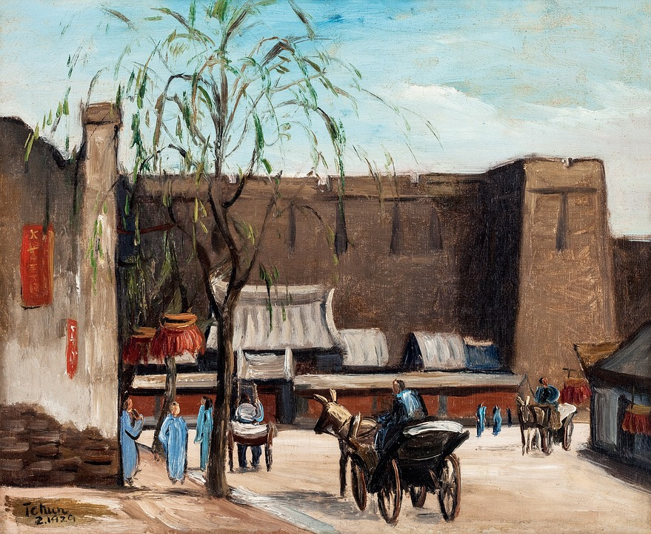
Justice & security
For Epicurus, the pursuit of stable pleasure requires seeking personal security from harm, especially the harm of other people.
“Any means by which it is possible to procure freedom from fearing other men is a natural good.” (Leading Doctrines 6)
Practical wisdom thus leads us to form agreements with others not to harm each other. Justice for Epicurus involves following such agreements.
“The justice that seeks nature’s goal is a utilitarian pledge of men not to harm each other or be harmed.” (Leading Doctrines 31)
“Nothing is either just or unjust in the eyes of those animals that have been unable to make agreements not to harm each other or be harmed. The same is true of those peoples who are unable or unwilling to make covenants not to be harmed.” (Leading Doctrines 32)
“Justice never was an entity in itself. It is a kind of agreement not to harm or be harmed, made when men associate with each other at any time in communities of any size whatsoever.” (Leading Doctrines 33)

Slide 24
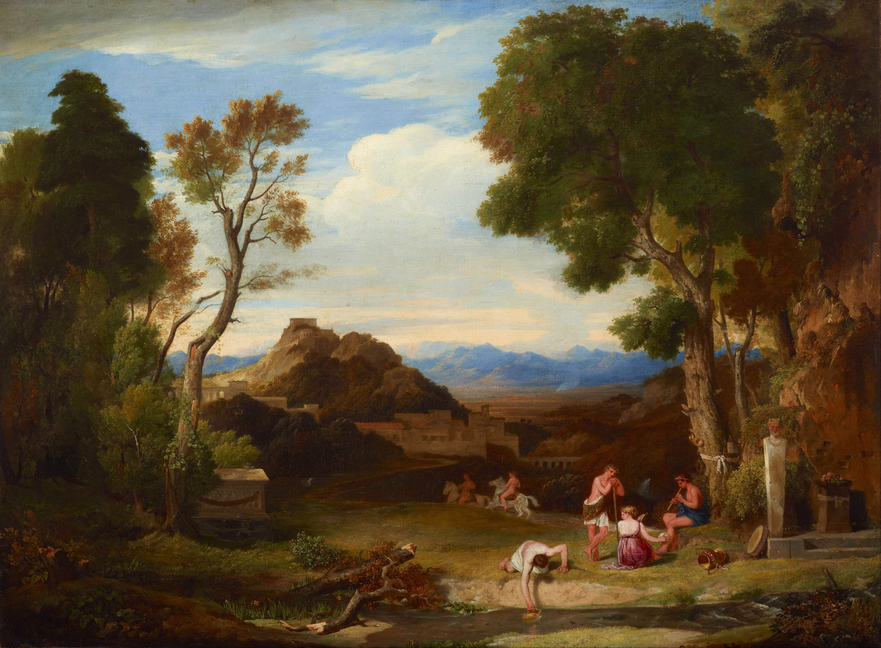
“Live unnoticed” Avoidance of political involvement
Epicurus cautions against entanglement in politics. He argues that happiness is best found in a private life.
Epicurean maxim: “live unnoticed” (see Cooper, p. 263)
“The simplest means of procuring protection from either men (which is gained to a certain extent by deterrent force) is the security of quiet solitude and withdrawal from the mass of people.” (Leading Doctrines 14)

Slide 25
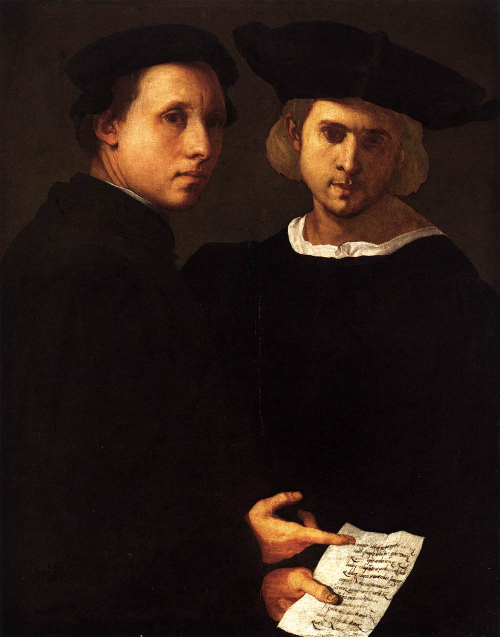
Epicurus on friendship
Epicurus argues that a great source of pleasure was to be found in having friends.
“Of all the things that wisdom provides for the happiness of the whole man, by far the most important is the acquisition of friendship” (Leading Doctrines 27)
“Every friendship is desirable for itself, but it has its origin in personal advantage.” (Vatican Aphorisms 23)
In his interpretation of the Epicurean view of friendship, John Cooper has argued that friendship is important for pleasure because it provides the ‘context’ for the richest, most complex pleasures.
“friendship provides the context for many or most of the activities of life that they [epicureans] find most appealing and challenging” (Cooper, p. 268)

Slide 26
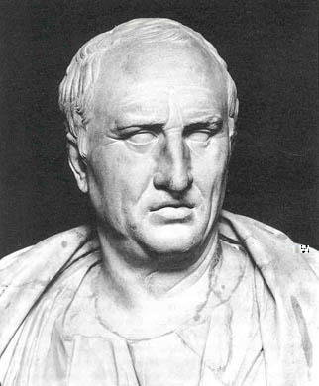
Cicero’s critique of the epicurean view of friendship
The Roman philosopher Cicero criticized the Epicurean view of Friendship as making true friendship as impossible.
On Cicero’s view, if we value friends primarily for the pleasure they give us, then we miss something important about friendship—namely, that we value a true friend for his/her own sake.
Cicero (106-46 BCE)

Slide 27
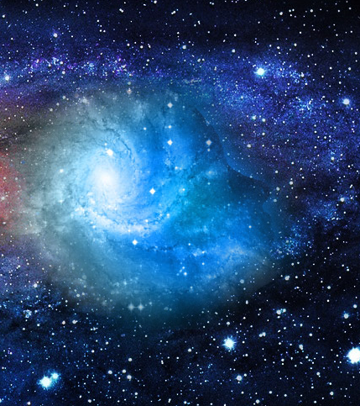
Epicurean Metaphysics & epistemology

Slide 28
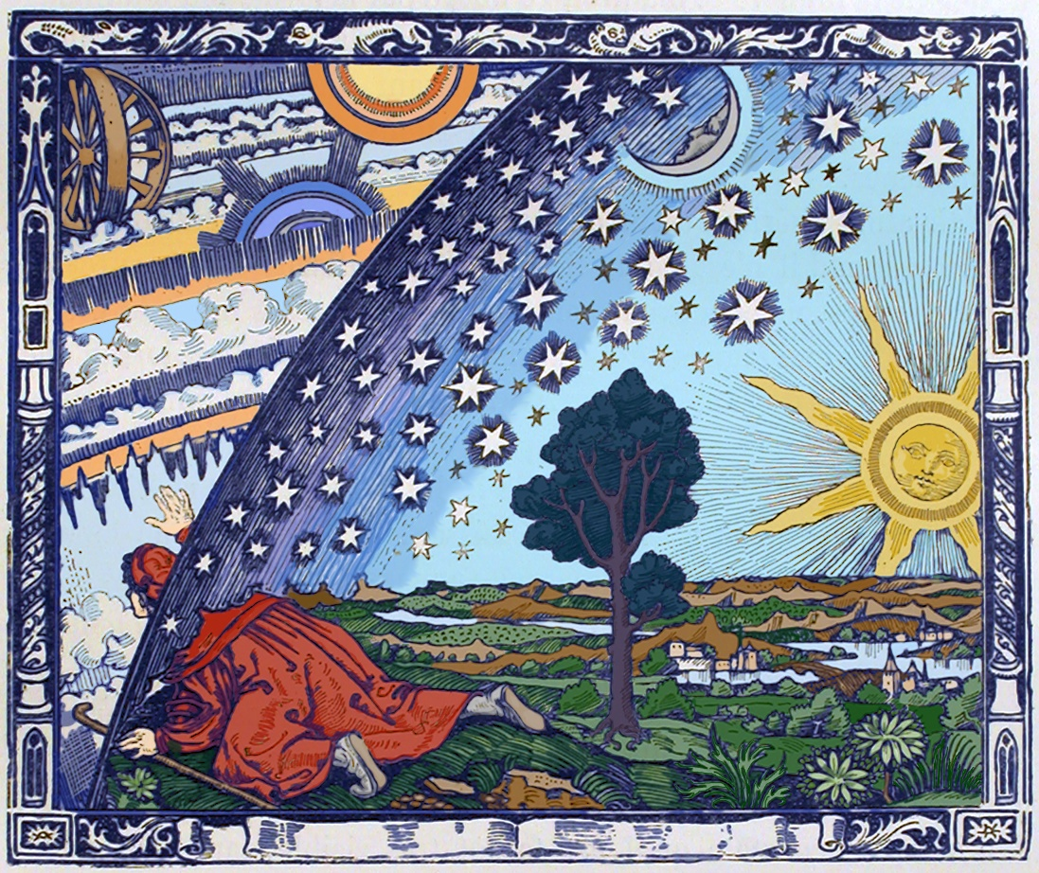
Why study natural science?
Epicurus argues that the study of the natural sciences has benefits for leading a happy life.
“We would have no need for natural science unless we were worried by apprehensiveness regarding the heavenly bodies, by anxiety about the meaning of death, and also by our failure to understand the limitations of pain and desire.” (Leading Doctrines 11)
“It is impossible to get rid of our anxieties about essentials if we do not understand the nature of the universe and are apprehensive about some of the theological accounts. Hence it is impossible to enjoy our pleasures unadulterated without natural science.” (Leading Doctrines 12)

Slide 29
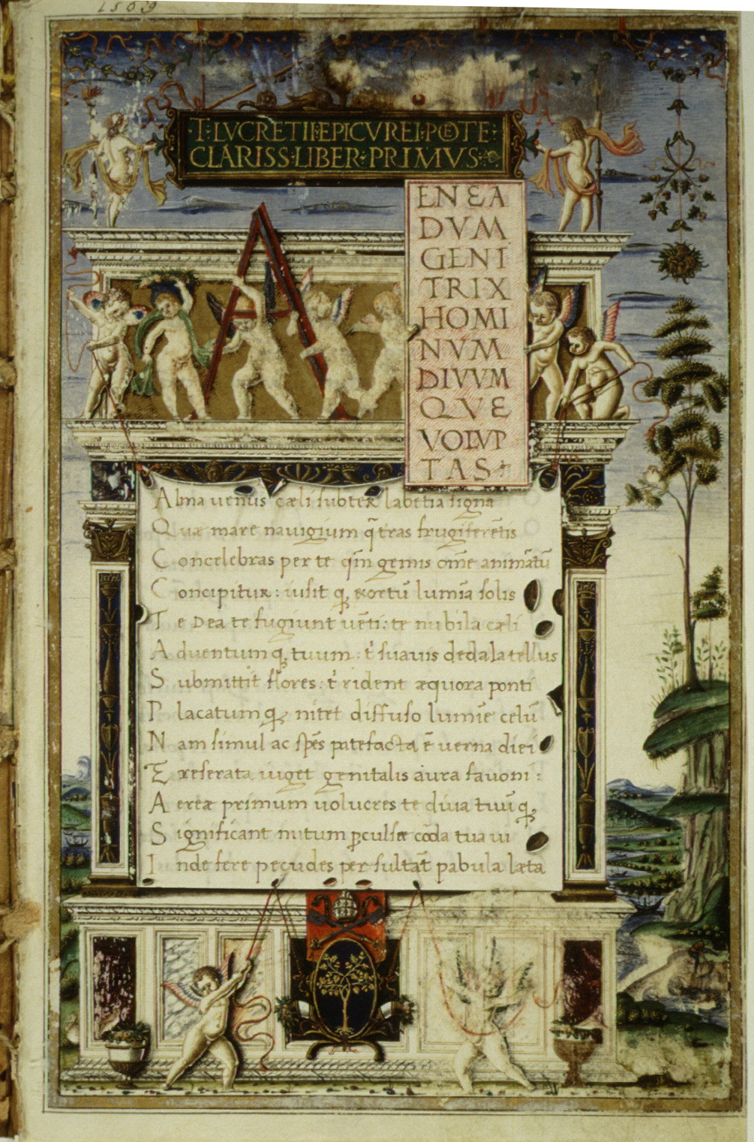
Epicurean view of nature
Nature for the Epicureans is conceived of the totality of atoms in void.
“the primal entities are necessarily indivisible corporeal entities.” (Letter to Herodotus, p. 94)
Nature is an infinite number of atoms dispersed in infinite space.
The atomic units are of various shapes:
“the compact and irreducible atomic bodies out of which compounds are generated and into which they are resolved have an indeterminate number of shapes, because it is impossible for so many different perceptible objects to be generated from the same shapes on the assumption that these are limited in number.” (Letter to Herodotus, p. 94)
These various atoms come into collision with each other (according to Lucretius because the atoms ‘swerve’ into each other).

Slide 30
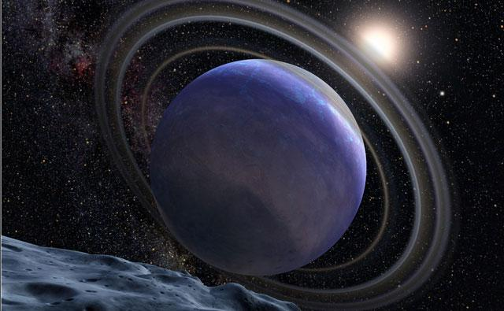
Epicurus on other worlds
As a result of the various collisions of atoms, Epicurus postulated the creation of multiple worlds of various varieties (both like our world as well as unlike it).
“there are infinite worlds—worlds like and unlike our own—because the atoms, being infinite in number…are in motion extremely far out in space; and atoms of the sort from which a single world could be generated or by which such a world could be constructed, have not been used up on the world or on a finite number of worlds, nor have they been used up on all worlds such as ours or on all worlds different than ours. So nothing stands in the way of there being an infinity of worlds.” (Letter to Herodotus, p. 95)
“other worlds, i.e., every finite aggregate that bears a strong resemblance to the phenomena we see—have been generated from the infinite, that all these systems, whether large or small, disengaged themselves from separate condensations of matter; and that they are all broken down again into their components…these worlds do not necessarily have a single form…For nobody can demonstrate that one such world might or might not have contained the kind of seminal particles of which animals, plants, and everything else we see are composed, but that in another such world this would have been an impossibility.” (Letter to Herodotus, p. 108)

Slide 31
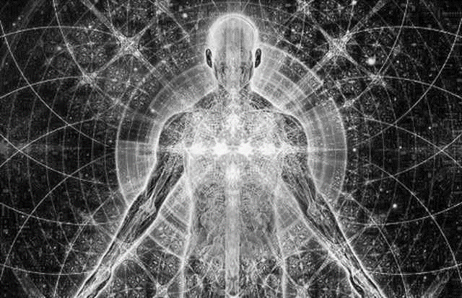
Epicurean view of soul
Epicurus offered a materialistic account of the soul:
“the soul is a body composed of fine particles that are dispersed throughout the entire organism, and that it bears the closest resemblance to breath with a certain admixture of head, being similar in some ways to the one and some ways to the other.” (Letter to Herodotus, p. 103)
“the soul plays the most important role in causing sensation but would never have achieved sensation unless it were somehow incorporated in the rest of the organism.” (Letter to Herodotus, p. 104)
“on the dissolution of the entire organism the soul is scattered abroad and no longer has its usual functions, nor does it undergo motion, with the result that it does not have sensation either.” (Letter to Herodotus, p. 104)

Slide 32

Epicurean epistemology
Epicurus developed an empiricist account of epistemology (how we know things). He argued that sensation is the foundation of our knowledge.
“If you reject all sensations, you will not have any point of reference by which to judge even the ones you claim are false.” (Leading Doctrines 23)
“If you summarily rule our any single sensation and do not make a distinction between the element of belief that is superimposed on a percept that awaits verification and what is actually present in sensation or in the feelings or some percept of the mind itself, you will cast doubt on all other sensations by your unfounded interpretation and consequently abandon all criteria of truth.” (Leading Doctrines 24)

Slide 33
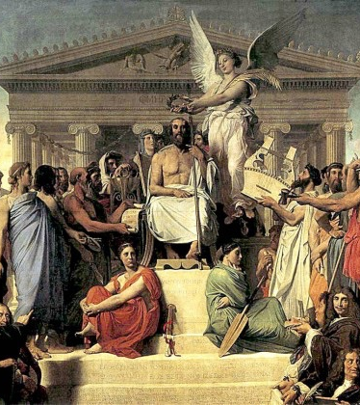
Epicurean view of religion

Slide 34
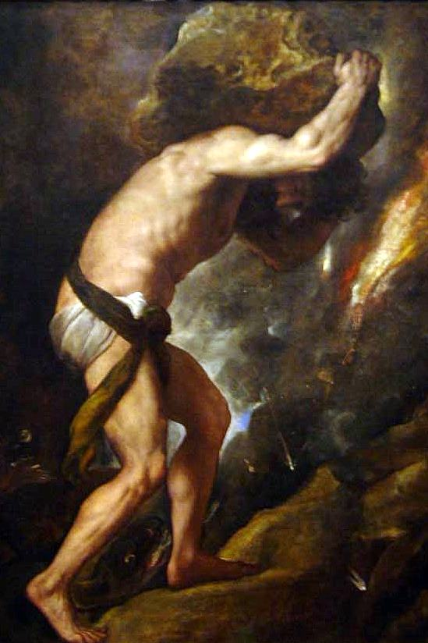
Popular view of the gods
The popular view of the gods saw them as having human-like concerns, temperaments, and tendencies and interfering with human life.
One source of fear among common people was the gods’ intervention in their lives.
Example: the gods’ punishment of Sisyphus.

Slide 35
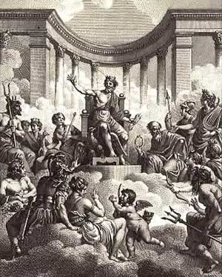
Epicurean view of the gods
Epicurus’ view of the gods didn’t deny their existence, but it denied popular conceptions of their temperament and activity.
Since the gods were perfectly happy, Epicurus argued, they were fundamentally uninterested in human affairs.
There is no reason to fear the gods, if one understands them correctly.
“The blessed and indestructible being of the divine has no concerns of its own, nor does it make trouble for others. It is not affected by feelings of anger or benevolence, because these are found where there is lack of strength.” (Leading Doctrines, 1)
“anything that suggests uncertainty or confusion has absolutely no place in our conception of the deathless and blessed nature of the divine.” (Letter to Herodotus, p. 110)

Slide 36
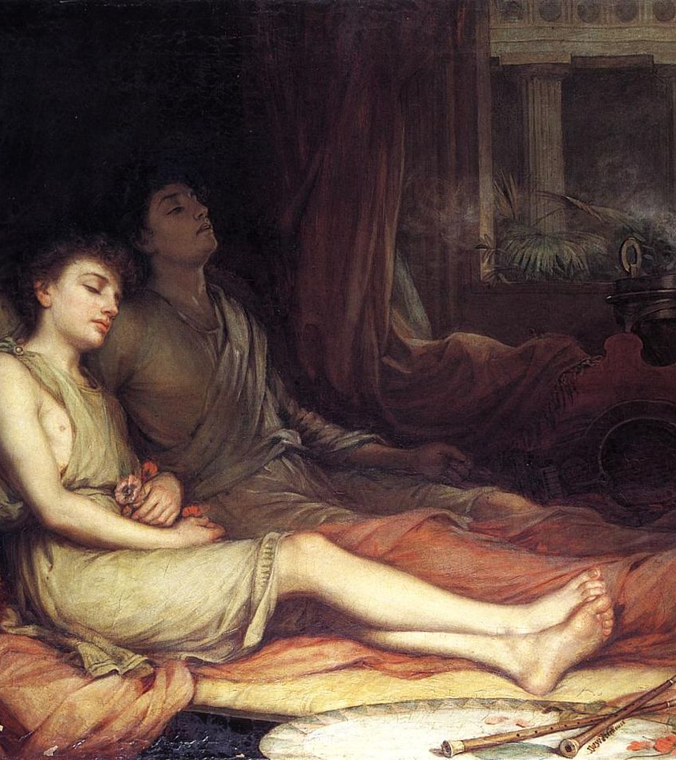
Epicurean view of death

Slide 37
Two epicurean arguments
The Epicureans saw fear of death as a source of anguish for human beings.
As a kind of therapy, they offered various arguments why we should not fear death.
Two notable arguments:
No Consciousness, No Harm Argument
Asymmetry Argument
Epicurus (341-270 BCE)

Slide 38
1. No consciousness, no harm argument argument
“death means nothing to us, since every good and every evil lies in sensation; but death is the privation of sensation.” (Epicurus, Letter to Menoeceus)
“Death …is nothing to us, seeing that, when we are, death is not come, and, when death is come, we are not.” (Epicurus, Letter to Menoeceus)
“Death means nothing to us, because that which has been broken down into atoms has no sensation and that which has no sensation is no concern of ours.” (Epicurus, Leading Doctrines 2)

Slide 39
1. No consciousness, no harm argument
P1. A person is either living or dead.
P2. If the person is living, then death isn’t a concern because they are alive.
P3. If the person is dead, then death isn’t a concern because there is no consciousness to experience anything.
C. Therefore, death is no concern.

Slide 40
2. The Symmetry Argument
Do you have profound regrets that you weren’t born in an earlier age?

Slide 41






2. The Symmetry Argument
In the US in the 1980s hairstyles & outfits like this were fashionable:

Slide 42
2. Symmetry Argument
Before your birth
Your Life
After your death

Slide 43
2. Symmetry Argument
X
Your Life
Z

Slide 44
2. Symmetry Argument
X
Your Life
Z
We don’t feel badly about the time before our lives, so why should we feel bad about the time after our lives?
There’s no relevant difference between X & Z. Both are just periods of non-existence.
Thus, it’s irrational to fear death.
X = Z

Slide 45
A critique of the epicurean view of death

Slide 46

Two arguments from Thomas Nagel (1970)
Against the No Consciousness, No Harm Argument** (for tutorial)
Against the Symmetry Argument
The Deprivation Account of Death’s Badness

Slide 47
Nagel’s Response to the Symmetry Argument
X
Your Life
Z
X ≠ Z

Slide 48
Nagel’s Response to the Symmetry Argument
X
Your Life
Z
Thomas Nagel has famously argued that the symmetry argument mistakenly assumes the period before our birth and the period after our deaths are the same.
But they are not—when we are born is fixed; when we die is not fixed.
X ≠ Z

Slide 49
Nagel’s Deprivation Account of Death’s Badness
Reasons why death isn’t bad:
The state of death is bad: this is a projection of the imagination.
The loss of one’s organism: even if our mere physical body persisted indefinitely (e.g., a coma), just this would be an equivalent loss.
Death is bad because it takes away good things.
This is a loss regardless of the natural limits of one’s life: even if one dies at a normal age, the thought one could live longer and enjoy more goods, shows it is still a loss.

Slide 50
Is Epicurean Philosophy a way of life?

Slide 51
Epicureanism as a way of life
Goal of Self-Transformation: Yes, the aim is to cultivate the right sorts of desires and satisfy the right sorts of pleasures to attain the most stable happiness.
Practiced as a Group: Yes, Epicurus lived with his friends and disciples in the pursuit of leading happy lives.
Ability to Change Oneself: Yes, it takes effort to cultivate the right pleasures and adopt good practices to be happy (e.g., learning to be content with bread and water).
Cosmic Consciousness: Yes, Epicurean natural philosophy is designed to cure our fears of gods and death (see Hadot, 2002, pp. 113-126)
Guided by Reason: Mostly no, as Cooper argues, for the Epicureans, reason plays only an instrumental role in helping us attain pleasure (see pp. 227-228, 271-76)

Slide 52
Bibliography
Cooper (2012). Pursuits of Wisdom. Princeton.
Epicurus (2012), The Art of Happiness, trans. George K. Strodach. Penguin.
Gutherie (1950). The Greek Philosophers: From Thales to Aristotle. Harper & Row.
Hadot (2004). What is Ancient Philosophy? Harvard UP.
Hadot (1998). Philosophy as a Way of Life. Blackwell.
Lucretius (2007). The Nature of Things, trans. A.E. Stallings. Penguin.
Robin (1996). Greek Thought: And the Origins of the Scientific Spirit. Routledge.

